Slide 1






Resume Keyword Highlighter
Presented by:
Ayush Kumar
Sweta Kumari

Slide 2

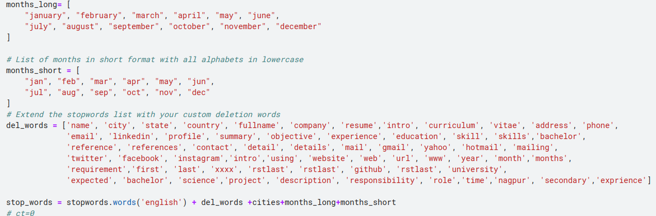

Data Collection and Preparation
Despite initially receiving a dataset, I undertook the initiative to further augment this collection by curating additional resumes from various sources.
Developed a meticulously curated list of words to be ignored during the resume analysis process. This exclusion list helped in eliminating noise and focusing the model's attention on relevant information that directly contributes to the accuracy of resume categorization and relevance matching.
Expanded the dataset's contextual understanding by incorporating a comprehensive list of cities from India and the USA. This step aimed to enhance the model's capability to recognize and differentiate location-based data within resumes

Slide 3

Preprocessing Techniques Applied
Implemented a comprehensive text pre-processing pipeline to cleanse and standardize resume data.
This included the removal of URLs, social media mentions, hashtags, RTs, and cc tags to ensure the text was free from irrelevant or noisy data.
Further, I eliminated all non-ASCII characters, punctuations, and numbers to focus on meaningful textual content.
Applied lowercasing and whitespace normalization across the dataset to maintain consistency.
Additionally, a custom filter was employed to exclude stop words and short tokens, retaining only significant words that contribute to understanding resume content effectively.

Slide 4


Model Selection
3
1
2
Opted for the state-of-the-art BERT (Bidirectional Encoder Representations from Transformers) model, specifically the bert-base-uncased variant, known for its effectiveness in understanding the context and nuances in text data.
Leveraged the transformers library by Hugging Face to access pre-trained models and tokenizers, enabling the application of transfer learning techniques to adapt the model to the specialized task of resume categorization and matching.
Developed a CustomDataset class inheriting from PyTorch's Dataset module. This class is tailored to tokenize and prepare the input data specifically for the BERT model, utilizing efficient batch processing to handle large-scale text data.

Slide 5


Tokenization & Masking
Dynamic Masking with Data Collator
Tokenization and Encoding:
Implemented the tokenizer within the initialization of the dataset, configuring it to handle text tokenization with truncation and padding to the maximum length, ensuring uniform input size for model training.
Employed DataCollatorForLanguageModeling with the tokenizer, enabling dynamic token masking with a 15% probability. This setup is essential for training the model using the Masked Language Modeling (MLM) objective, which is fundamental to BERT's training methodology.
1

Slide 6
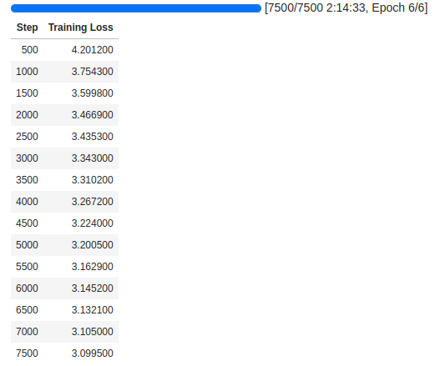
MLM Probability Setting: The mlm_probability parameter was set to 0.15, meaning that there was a 15% chance of any given token being masked out in the training data.
MLM Training Objective: The model learns to predict the original identity of the masked tokens based on the surrounding context. This process not only helps in learning deep contextual representations but also allows the model to focus on understanding the entire context of the input sequence.
Model Fine-Tuning and Persistence:

Slide 7

Result
For each line of text, I performed a series of cleaning operations including the removal of any '.js' and .NET substrings, which commonly observed in technical resumes. Following this, non-ASCII characters were filtered out to standardize the text for processing.
The cleaned lines were then split into individual chunks using period separators.
To ascertain the relevance of each sentence to the job category in question, I employed cosine similarity measures. This method allowed me to compare the sentence embeddings with a vector representative of the resume category.
The similarity scores for each sentence were stored in a dictionary, associating text chunks with their respective relevancies.

Slide 8


Thank
you

